Slide 1
Final Year Project
Project Name: SMART Q’BANK SOLUTION
Project - II (ECS44402)
ADAMAS UNIVERSITY
2022

Slide 2
Team Members
Ayontika Das | UG/02/BTCSE/2018/055​
Dishari Mondal | UG/02/BTCSE/2018/067​​
Om Tiwari | UG/02/BTCSE/2018/054​
Anurag Pattnayak | UG/02/BTCSE/2018/046​​

Slide 3
Mrs. Riya Sil
(Asst. Professor, Dept. of CSE)
Our Mentor

Slide 4
CONTENTS OF THIS PROJECT….
Central Idea
Who will be Benefitted?
Understanding the problem
Projected Solution
What we are working
Project Requirements
Result
Future Implementation
Conclusion

Slide 5
CENTRAL IDEA OF THIS PROJECT...
The project focuses on the development and deployment of a smart solution for subject-wise preparation of question banks for implementation at an institution. In this web platform it aims to create a database of questions on an IT-supported platform and provide the faculty with options to create different types of question papers of varying difficulty levels on demand.

Slide 6

Who will be benefitted?
Faculties can refer to the Question bank for the purpose of setting the question papers for internal assessment as well as for their term end examination.
Teachers can also refer to question bank for continuous evaluation of students. After completing one unit of any course, teachers can give some assignments to students to workout based on this question bank.

Slide 7
UNDERSTANDING THE PROBLEM
Nowadays a huge part of the studying system and preparation for exams has become online based on this post-Covid situation. Teachers does not get the students for face to face checking their preparation every time.

Slide 8

PROJECTED SOLUTIONS
Authentication
Log in
Sign up
Different Dashboards for the User Roles:
- Contributor
- Reviewer
- Admin
Question Creation & Audit
Selecting types of questions
- MCQ
- Short Questions
- Long Answer type etc

Slide 9
PROJECTED SOLUTIONS……..
Selecting Difficulty Level
- Easy
- Medium
- Hard
Experts review by other members of faculty
User added by admin
Enhancements

Slide 10
WHAT WE ARE WORKING ON
01
02
03
04
FrontEnd Design
Backend Design
Integration with FrontEnd
Deployment

Slide 11
Project Requirements
TECHNOLOGY
For FrontEnd :
- ReactJS
- Redux
For Page Design :
- Material UI
For Backend :
- Node.JS Express
- MariaDB For Backend DataBase.
- MVC Framework

Slide 12

ReactJS
Open-source flexible, declarative JavaScript library that is easy to use to build interactive, scalable, simple, and fast frontend interfaces for single-page or multi-page web apps.
React creates a more responsive UI (user interface) that is very easy for developers.
Applications are highly testable.
It adds dynamic features to the project using JavaScript

Slide 13

Material UI
Flexible set of components, guidelines, and tools that enable user interface designing very easily.
Modern package that allows developers to use and import multiple components in React apps to construct user interface.
Provides extensive documentation that makes it simple to traverse through the framework.
Do not have to rewrite everything from the beginning, this saves a lot of time for the project

Slide 14

MariaDB
Open-source relational database management system (RDBMS).
Supports JSON APIs, concurrent data replication, and various storage engines, among other things.
Support for current SQL and JSON, Oracle Database compatibility, high availability, and robust security.
Utilized as fast, scalable, and resilient, with a rich ecosystem of storage engines, plugins, and other tools that make it highly adaptable for a wide range of use cases.

Slide 15

Node.JS Express
Web application framework that offers a comprehensive range of functionality.
Using a variety of HTTP utility methods and middleware, powerful API can be built quickly and easily.
Defines a routing table for doing various actions based on HTTP Method and URL
Allows to render HTML pages dynamically by supplying the variables to the templates.

Slide 16

MVC Framework
Model-View-Controller (MVC) architecture pattern has three logical components: model, view, and controller.
Each of these three components is designed to handle the specific parts of application development.
It divides any application development into these parts.

Slide 17
Map Question to units (Under respective paper)
Create
Question
Paper
State Marks for the Questions w.r.t each tagged unit
Questions Creation :
Choose type of Question
Map Question to “type” e.g., Short, Descriptive etc
Submit for Review
Define Difficulty Level

Slide 18
Peer review by other faculties of the department to which the concerned user belongs
Finalised & Approved Questions
Review Process :
Question Creation by faculty Members
Submit for Review
Rejected or changes required
Updated questions after incorporating review points

Slide 19
NOW
Page design
Coding
Deployment

Slide 20


Result

Slide 21
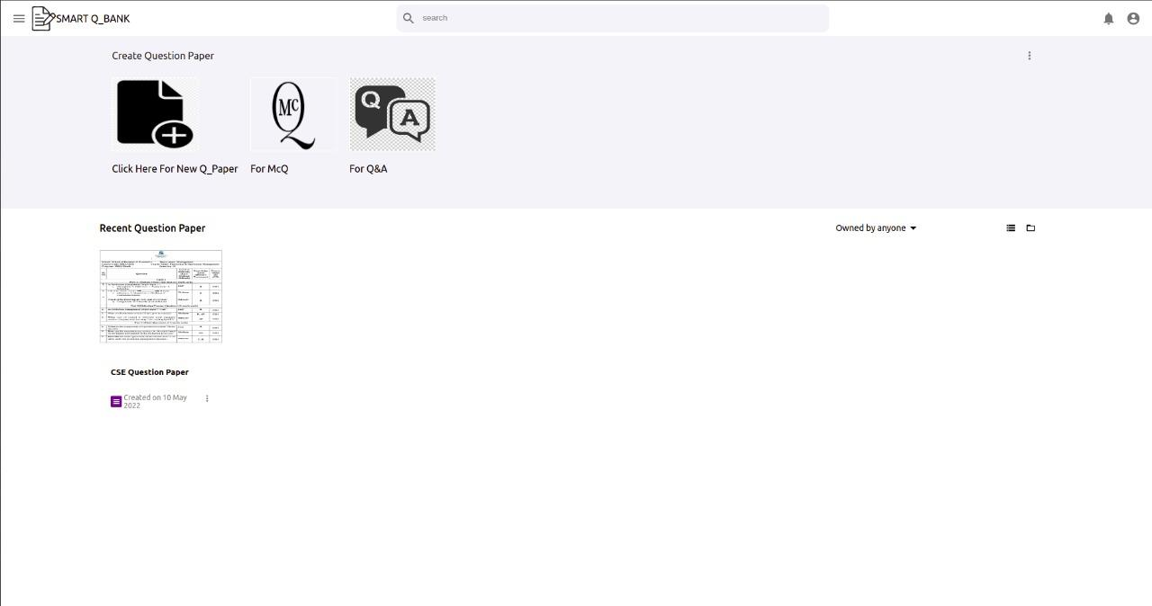
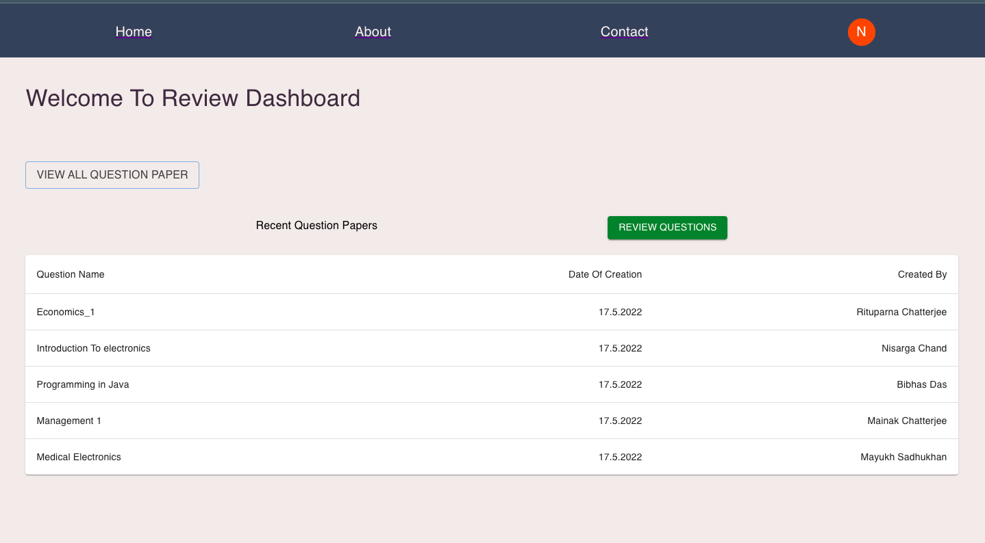
Result

Slide 22
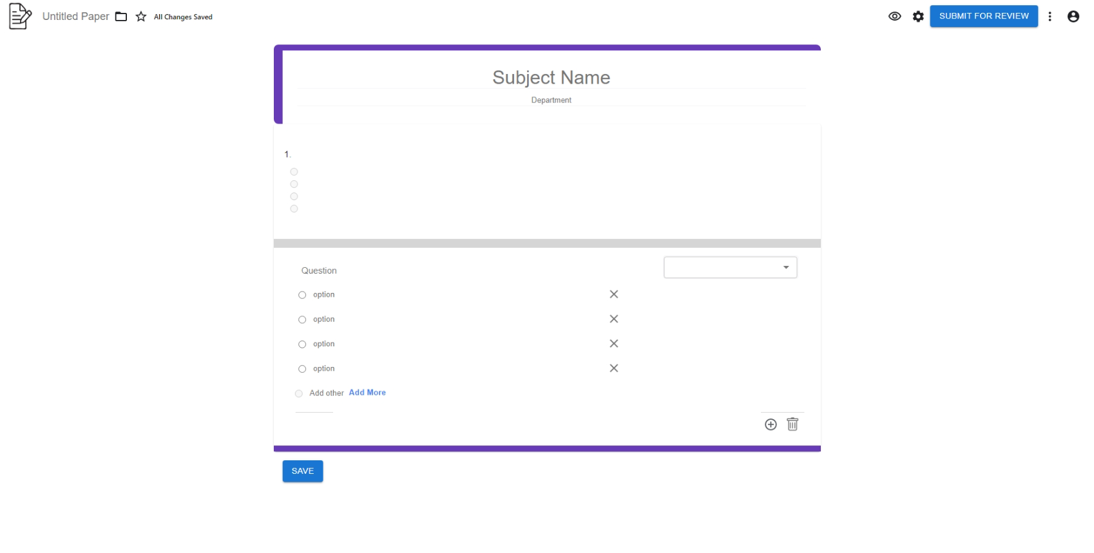
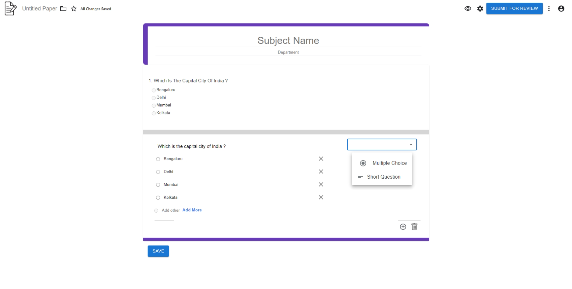
Result

Slide 23
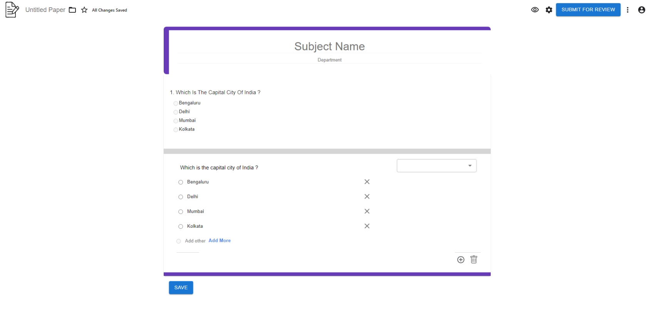
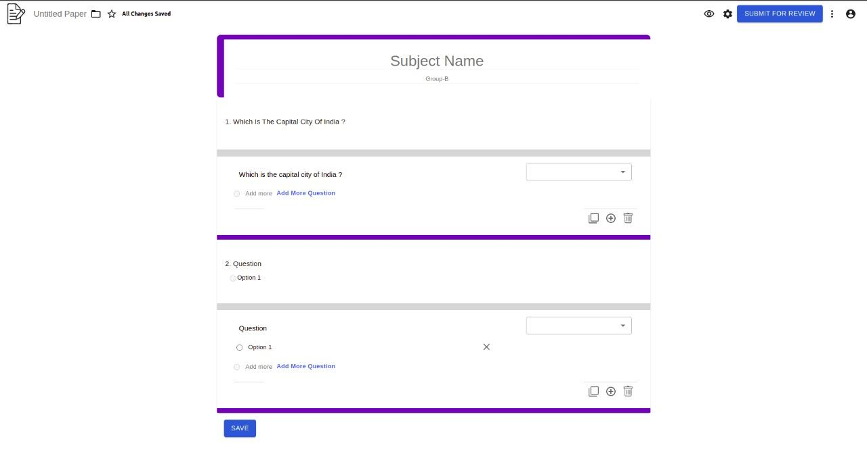
Result

Slide 24
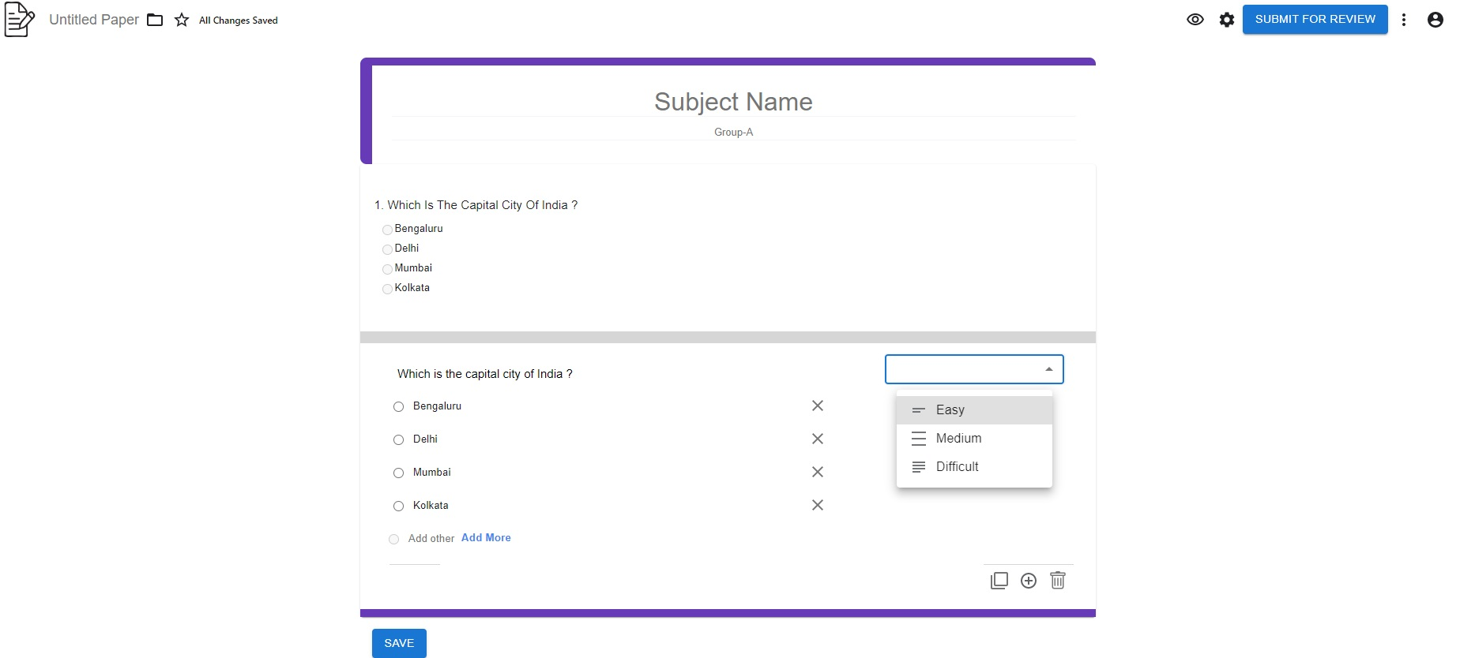

Result

Slide 25
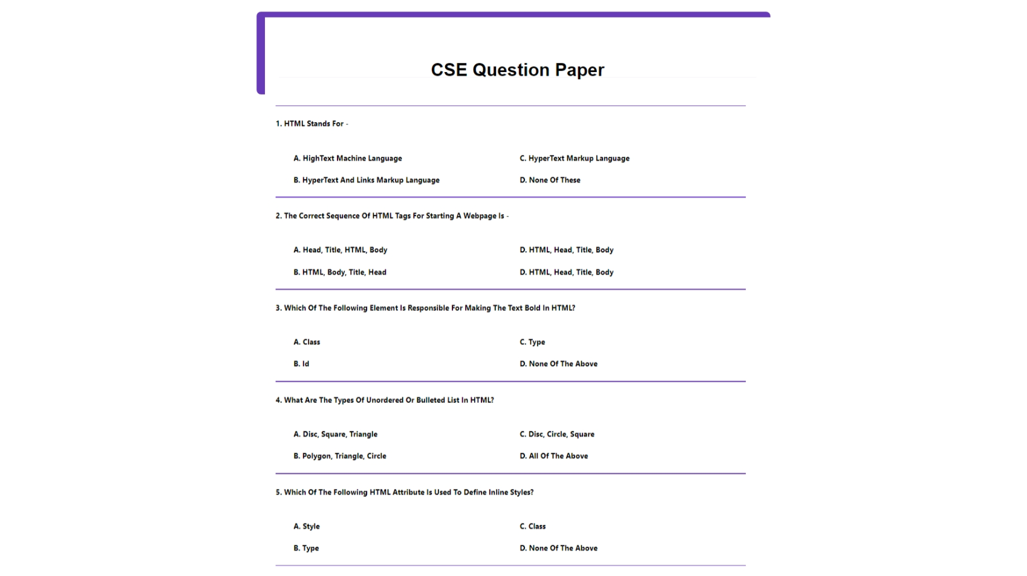
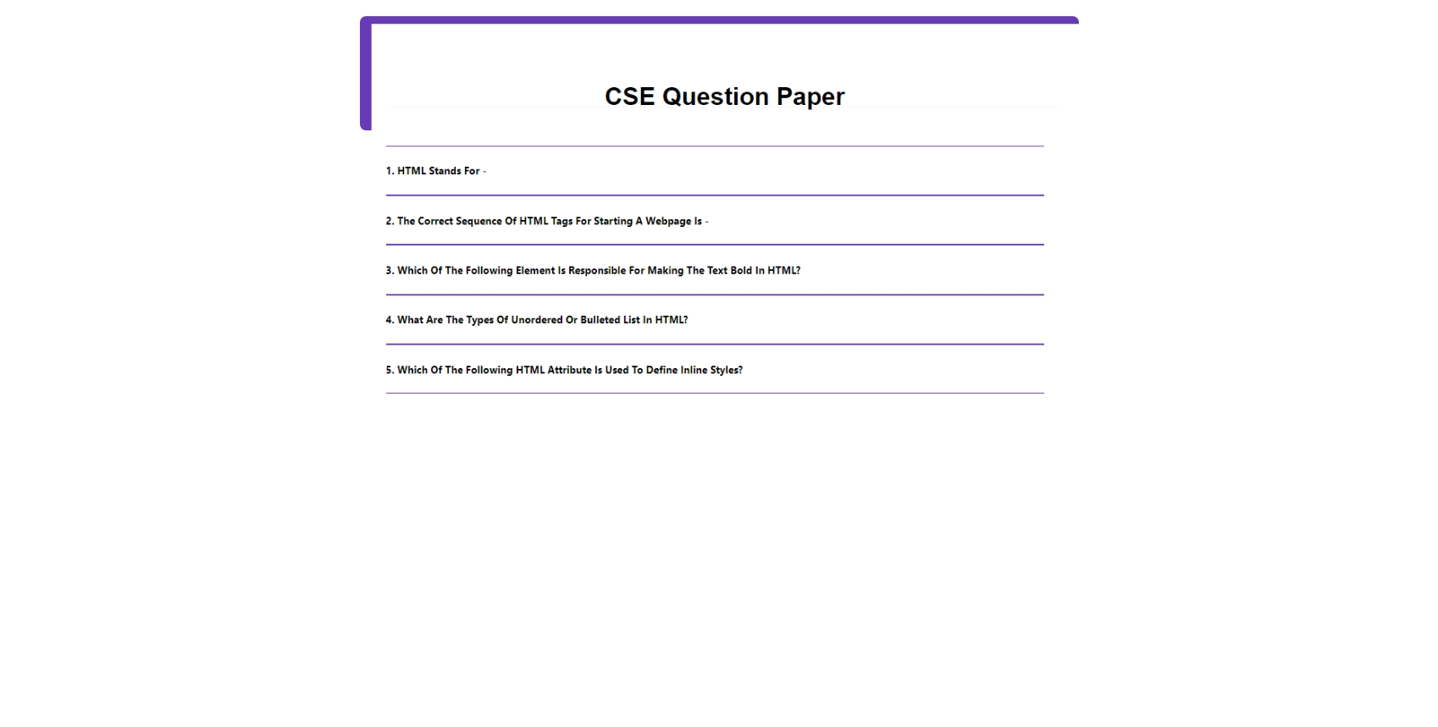
Result

Slide 26
Future Implementation
Basic AI Implementation
Question paper according to the Matrix
Bloom’s Taxonomy

Slide 27
Conclusion
From a proper analysis of positive points and constraints on the component, it can be safely concluded that the product is a highly efficient study preparation-based component. This application will work properly and meeting to all user requirements. This component can be easily accessible to the faculties, reviewers and admins. So, in all ways, we can conclude that this project is viable both technically and economically and it will have high IT demand.

Slide 28
THANK
YOU

